Slide 1

REGRESSION & CURVE FITING
DSML

Slide 2
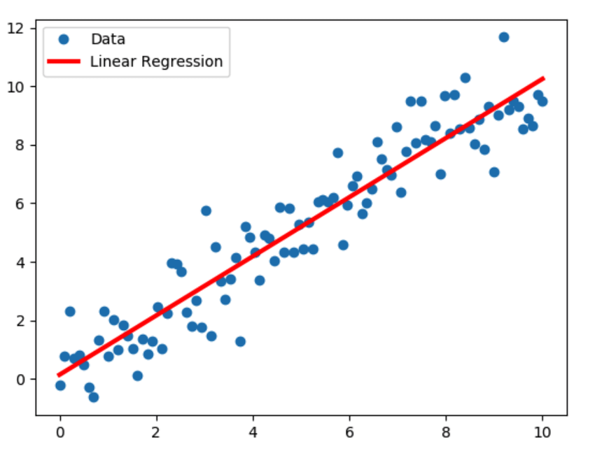
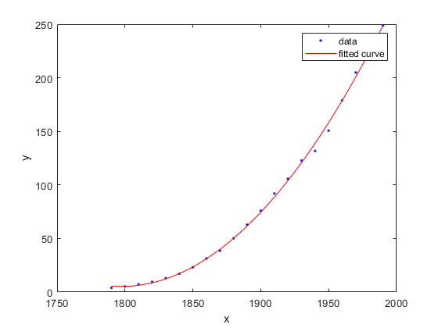
FITTING FUNCTIONS TO DATA POINTS
REGRESSION IS THE PROCESS OF DETERMINING THE RELATIONSHIP BETWEEN A DEPENDENT VARIABLE AND ONE OR MORE INDEPENDENT VARIABLES
Data Squad | Statistics Introdution

Slide 3
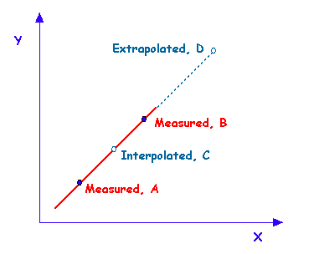
WHAT IS REGRESSION USEFUL FOR?
INTERPOLATION: MAKE PREDICTIONS ABOUT VALUES WITHIN MEASURED RANGE OF SAMPLE
EXTRAPOLATION: MAKE PREDICTIONS BEYOND RANGE OF DATAPOINTS AVAILABLE
Data Squad | Statistics Introdution

Slide 4
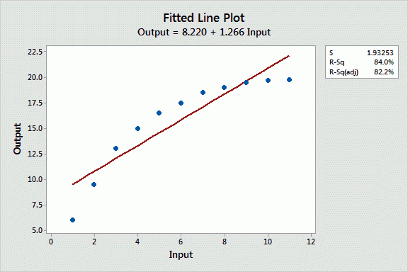
CHALLENGES IN REGRESSION
WHAT IS THE FUNCTION FAMILY THAT WE SHOULD USE TO PERFORM OUR FIT?
WHAT ARE THE BEST PARAMETERS TO FIT THE FUNCTION TO THE DATA?
Data Squad | Statistics Introdution

Slide 5
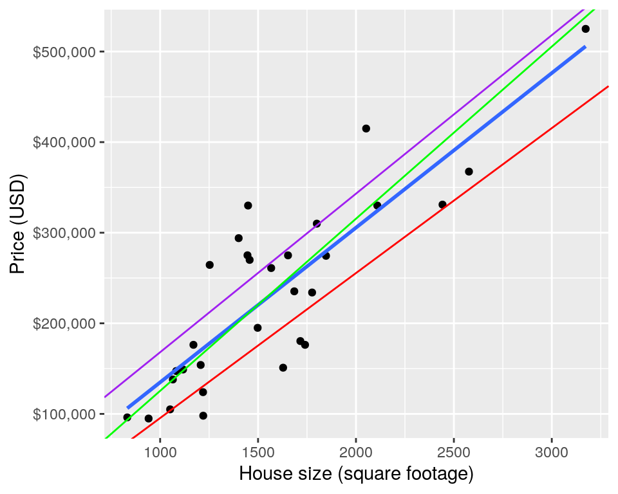
CHALLENGES IN REGRESSION
WHAT IS THE FUNCTION FAMILY THAT WE SHOULD USE TO PERFORM OUR FIT?
WHAT ARE THE BEST PARAMETERS TO FIT THE FUNCTION TO THE DATA?
Data Squad | Statistics Introdution

Slide 6
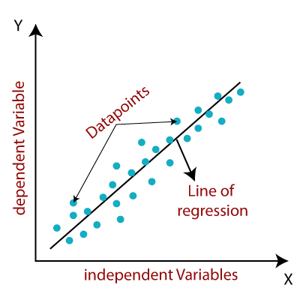

LINEAR REGRESSION
A STRAIGHT LINE IS GIVEN BY THE EXPRESSION BELLOW
BETA_0 IS THE Y-INTERCEPT
BETA_1 IS THE GRADIENT
Data Squad | Statistics Introdution

Slide 7

LINEAR REGRESSION MODEL
IN PRACTICE WE KNOW THAT OTHER VARIABLES MAY IMPACT THE TARGET VARIABLE.
THESE ARE ASSUMED TO BE PART OF THE RANDOM ERROR
Notes:
FOR REGRESSION TO BE EFFECTIVE, THE RANDOM ERRORS ARE ASSUMED TO BE MODELLED BY A NORMAL DISTRIBUTION WITH MEAN 0
THE MOST COMMON METHOD TO THEN EXTRACT THE BEST VALUES OF THE MODEL PARAMETERS IS KNOWN AS LEAST SQUARES REGRESSION
Data Squad | Statistics Introdution

Slide 8
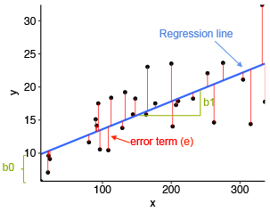
LINEAR REGRESSION MODEL
Data Squad | Statistics Introdution

Slide 9


HOW EXACTLY DO WE GET THOSE VALUES?
PREDICTION
EACH RESIDUAL IS THE REAL VALUE MINUS IT'S PREDICTION: THE ERROR!
Find b0 and b1 that minimize this value:
Data Squad | Statistics Introdution

Slide 10

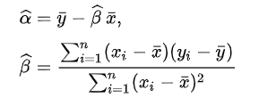

HOW EXACTLY DO WE GET THOSE VALUES?
PREDICTION
WE CAN COMPUTE THE COEFFICIENTS BY:
OR IN AN ALTERNATIVE NOTATION
Data Squad | Statistics Introdution

Slide 11
REFERENCES
CHAPTER 11, NEWBOLD, CALSON, THORNE, STATISTICS FOR BUSINESS & ECONOMICS
Data Squad | Statistics Introdution
Data Squad | Statistics Introdution

Slide 12
ANY QUESTIONS ?

